Slide 1
PRTC Class B - A New PRTC Option for Evolving Time Services Needs
ITSF George Zampetti 2018

Slide 2
Structure of ITU-T Sync Requirements
Solutions for frequency: G.826x
Solutions for Time/Phase: G.827x
Definitions /
terminology
G.8260: Definitions, metrics
Basics
G.8261
included in
FTS APTS/PTS
(Accuracy level 4/5/6) (Accuracy level 4)
G.8271
Network
requirements
G.8261.1
SyncE
G.8271.1(lev.4/ 5/6)
G.8271.2 (lev.4)
2018
G.8273
Clocks
G.811 PRC
G.8272 PRTC Class A /B
G.811.1 ePRC
G.8272.1 ePRTC A /B
G.8273.1 T-GM
G.812 SSU
G.8262 EEC
G.8273.2 -A/-B/-C
FTS: T-BC/T-TSC
G.813 SEC
G.8262.1 eEEC
2018
G.8273.3 FTS: T-TC
2018
G.8266 T-GM
G.8273.4
APTS: T-BC/T-TSC
Methods
Architecture
G.8264
G.8275
G.8265
Profiles (Protocol)
G.8265.1
G.8275.1 FTS
G.8275.2 PTS
Related recommendations
PRTC-B:
Scheduled for consent Oct 2018
Needs multi-band GNSS
Synchronization Layer Functions
G.781
G.781.1
2018
Interfaces
G.703
Technical Report
TR GNSS
Legend:
2019
Agreed
ongoing
Planned for yyyy
OAM
G.Suppl.SyncOAM
2018
Simulation Background
G.Supp.sim
2018
Deutsche Telekom , Helmut Imlau, 28.06.2017
Notes:
13.08.2007
2
Autor / Thema der Präsentation

Slide 3
PRTC-B Chronology
December 2016
PRTC Class B initiated by a group of operators: Deutsche Telekom, Orange, Austria Telekom, Swisscom
  “The current PRTC specification at G.8272 is technologically based on single-band L1 GNSS receivers”
  “It is possible to improve noise performance in locked mode significantly using dual-band L1/L2 receivers.”
Microsemi
  “Multiband GNSS receivers can be utilized to actively compensate for ionospheric time delay.”
March 2017
Deutsche Telekom, Orange, Austria Telekom, China Mobile initial proposal of PRTC-B performance requirements
June 2017
Deutsche Telekom, Orange, Austria Telekom, Swisscom, China Mobile, Microsemi, ADVA: PRTC-B added to G.8272 draft
September 2017
PRTC-B performance requirements added to G.8272 draft
TODO COMPLETE CHRONOLOGY

Slide 4
PRTC-B Draft Performance Requirements
Time accuracy:
<=40ns to UTC
MTIE
TDEV

Slide 5
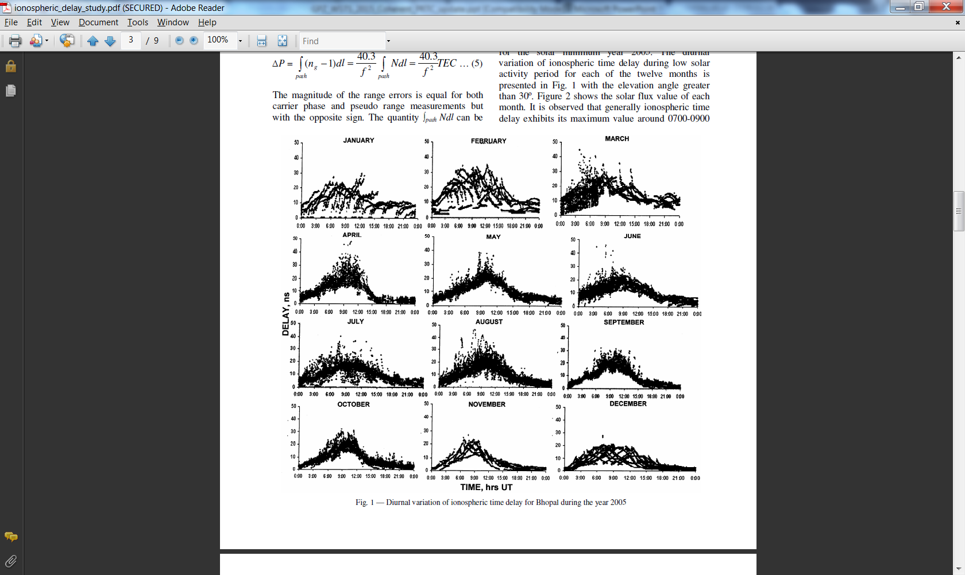
Ionospheric Delay Budget Considerations
GNSS Time Error highly dependent on delay variations through Ionosphere
12 months of delay variation data from study in Bhopal India during solar minimum period (2005)
All graphs scaled to 50ns.
Both Strong Diurnal as well as monthly (seasonal) delay variations are introduced by “Ionospheric Weather”
Other unintentional or intentional sources of spoofing will map to delay variation error as well
For perspective 50ns represents about 30 meters effective change over a 20000 km path from the GNSS satellite.
Bhattacharya S, Purohit P K, Gwai A K, “Ionospheric time delay variations in the equatorial anomaly region during low solar activity using GPS”, Indian J Radio Space Phys., Vol. 38,2009, pp. 266-274

Slide 6
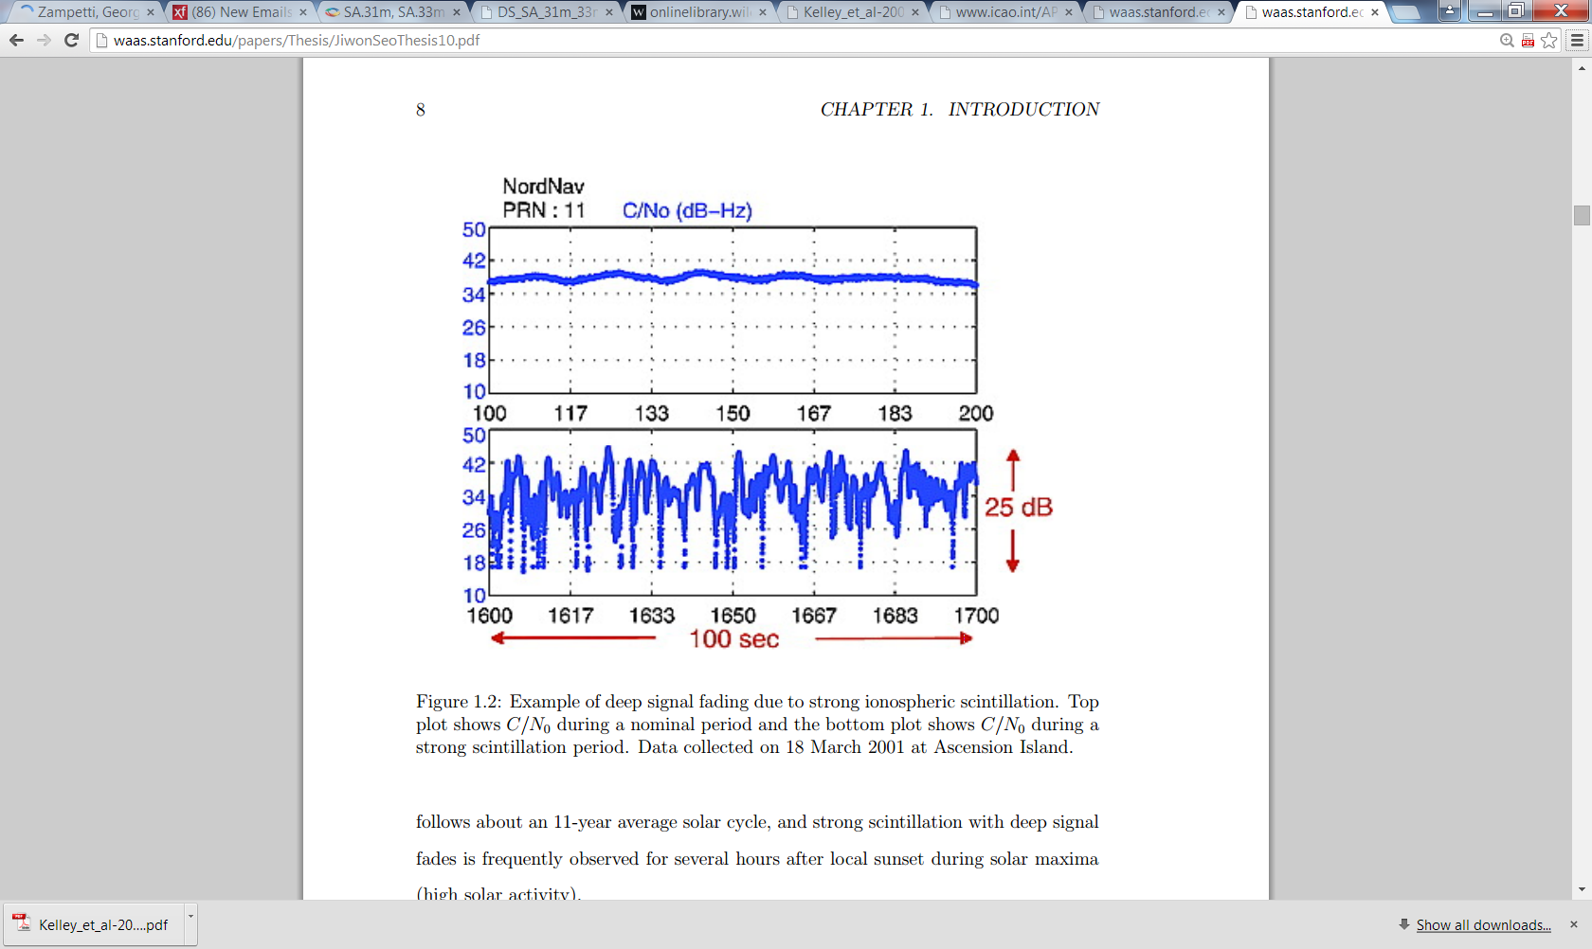
Ionospheric Scintillation Fading Considerations
Ionospheric Scintillation Fading occurs when under solar transient situations multiple delay paths co-exist through ionosphere.
In example shown the fading was deep 25dB.
Scintillation is a chaotic behavior resulting from “churn in the ionosphere”.
This is not a simple common mode term that generates the same delay effects over a local distribution.
Seo, Jiwon, Per Enge, J. David, Powell, Todd Walter, and Stanford University. Department of Aeronautics & Astronautics. "Overcoming Ionospheric Scintillation for Worldwide GPS Aviation." Overcoming Ionospheric Scintillation for Worldwide GPS Aviation. N.p., n.d. Web.

Slide 7
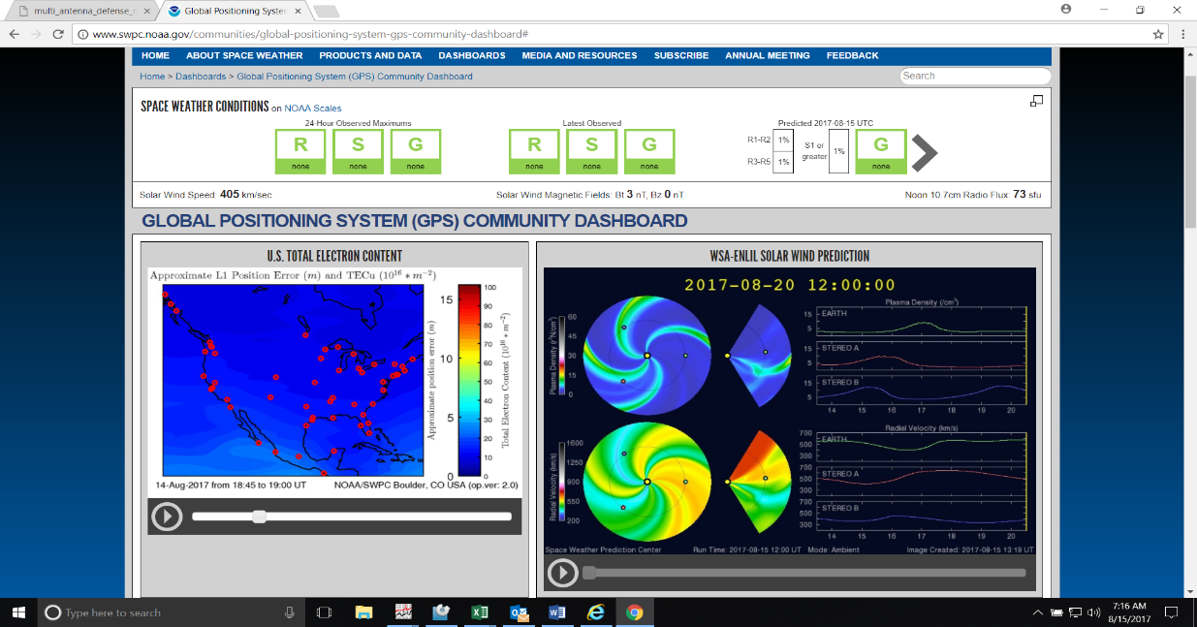
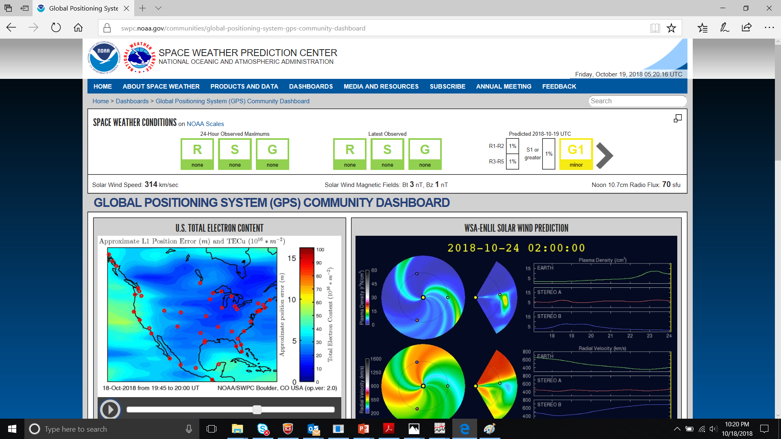
Ionospheric Space Weather (Does Change)
August 2017
October 2018

Slide 8
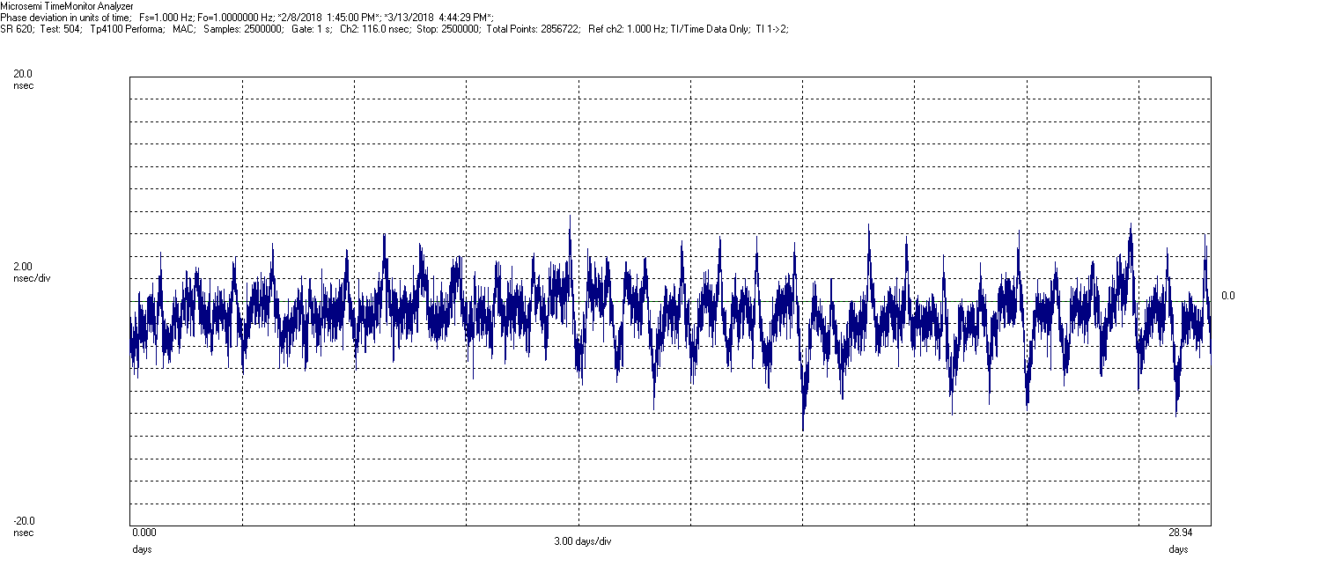
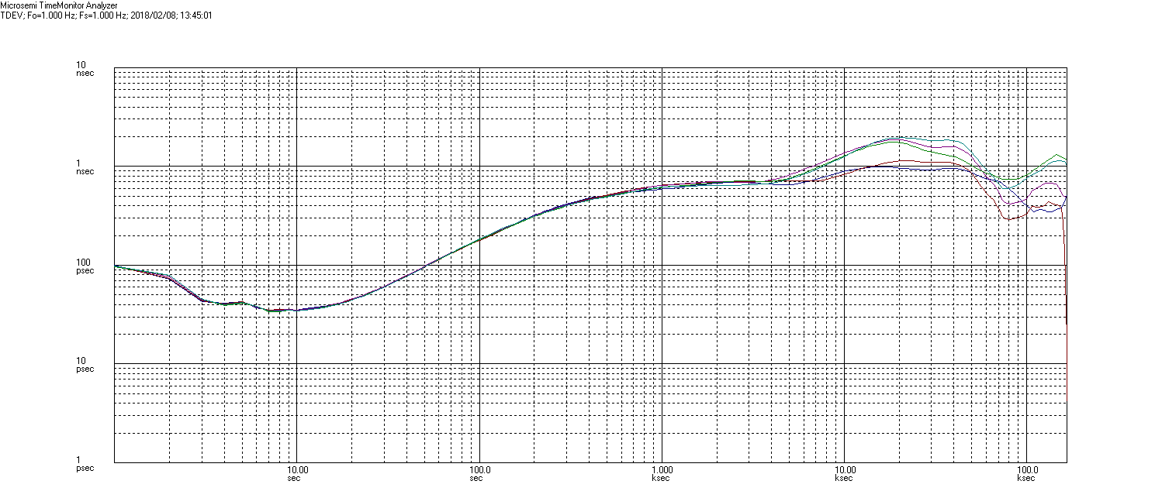
L1 Only Receiver 30 Day March 2018 (Increasing Diurnal)
Evidence of a Daily Delay Variation that appears to increase over the 30 test period.
Ionosphere space weather is currently minimal no guarantee this will continue.
Note absolute accuracy requires calibration of all delay components including cable and L-Band Distribution

Slide 9
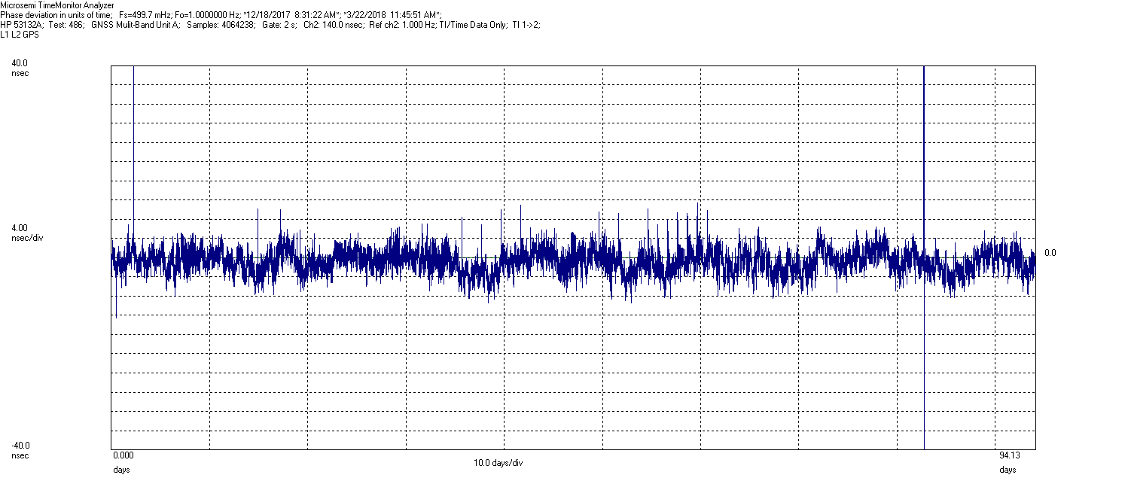
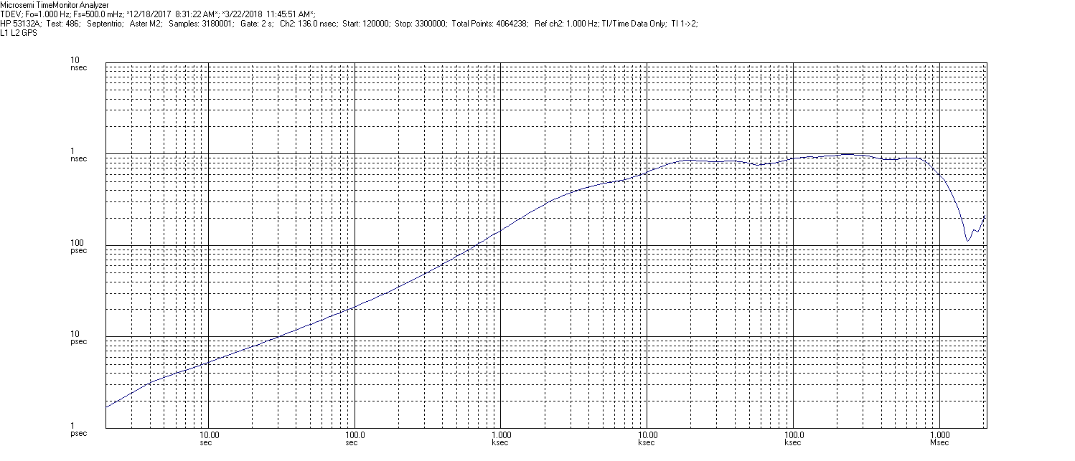
L1-L2 Receiver 90 Day Baseline
Long 90 day Baseline shows excellent performance
Sub-Nanosecond Performance stability over all observation windows

Slide 10
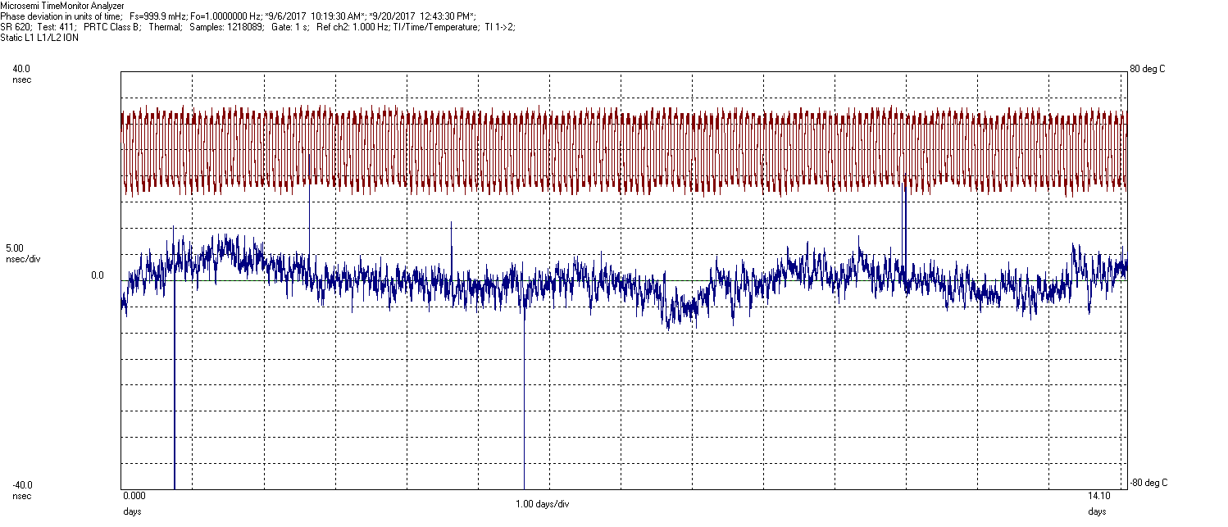
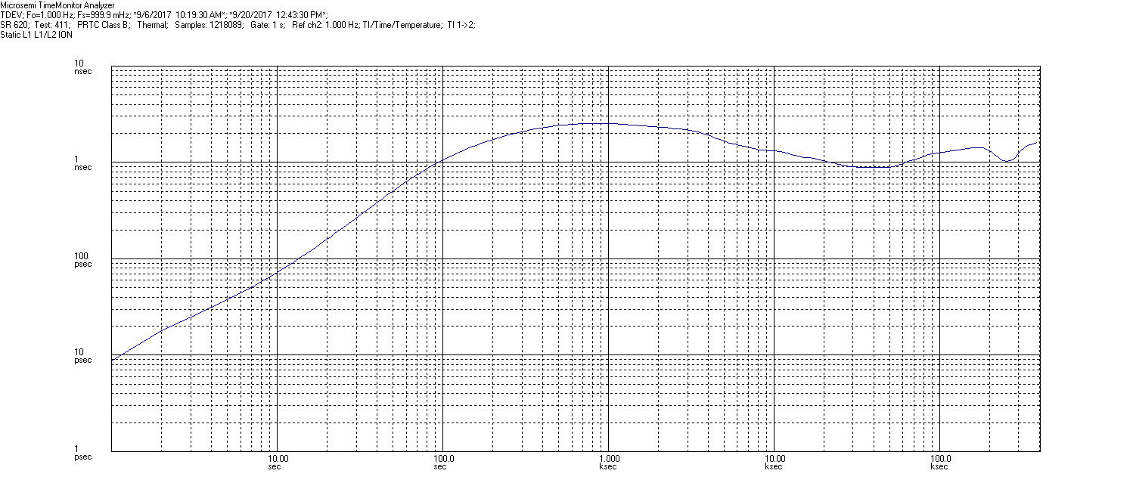
L1-L2 Receiver Temperature Sensitivity
Small correlation with temperature (less than 2ns peak on plot)
Infrequent transients on input readily filtered by clock algorithm.
No evidence of diurnal ionospheric contribution

Slide 11
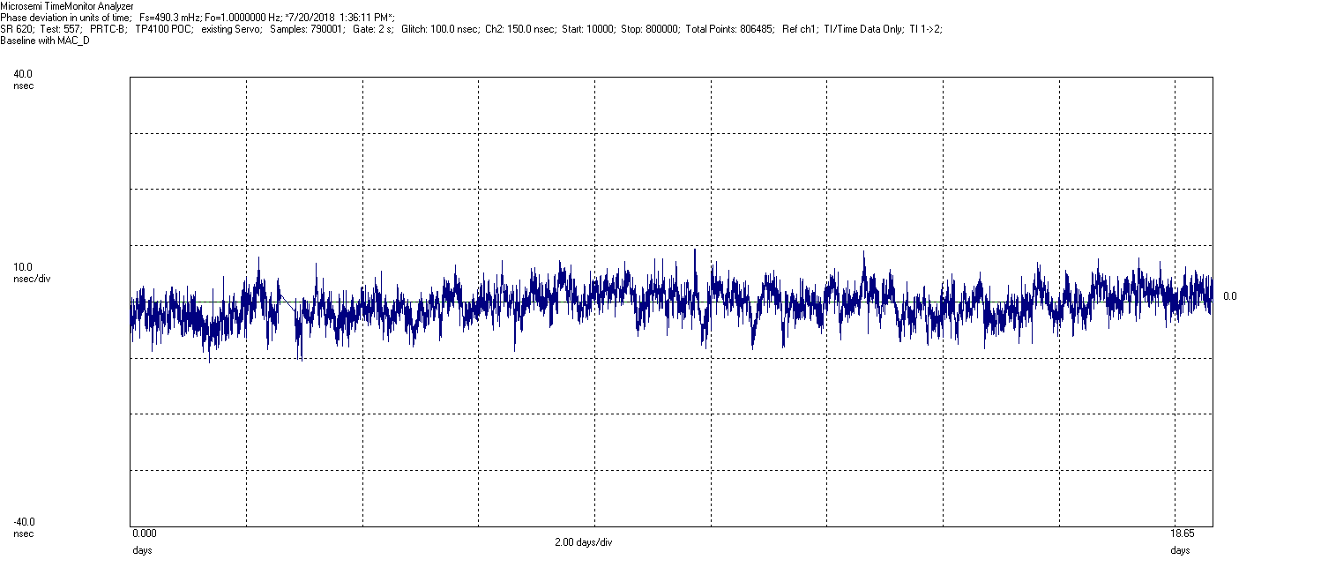
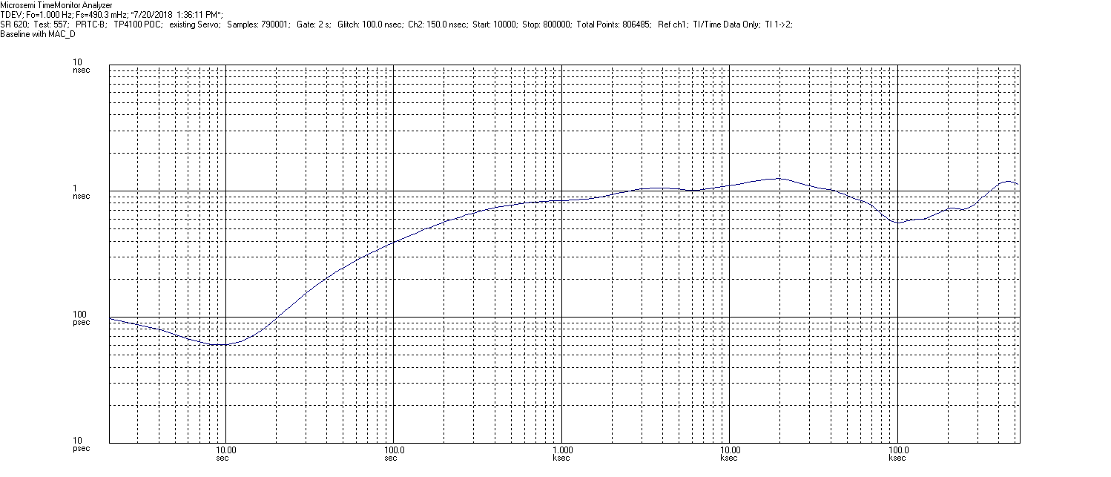
PRTC-B TP4100 Multi-Band 18 Day Baseline Test
Time Error Plot scaled to 40ns clearly showing achieved performance margin.
Infrequent transients on input readily filtered by clock algorithm.
No evidence of diurnal ionospheric contribution
TDEV stability peaks at nominally 1ns 5x better than specification.

Slide 12
Conclusions
PRTC-B supports a significant improvement in the time service budget (40ns as compared to 100ns).
PRTC-B multiband receivers are fundamentally robust to space weather.
Trends in GNSS applications requiring multiband technology for a wide range of applications in precise PNT can be leveraged for timing.
PRTC-B systems are now available for operator evaluation.

